Slide 1
Module 5.6: Cookies, Frames and Frame Busting

Slide 2
Cookies: client state

Slide 3
Cookies
Used to store state on user’s machine
POST …
Server
Browser
HTTP Header:
Set-cookie: NAME=VALUE ;
domain = (who can read) ;
expires = (when expires) ;
secure = (only over SSL)
If expires=NULL:
this session only
Server
Browser
POST …
Cookie: NAME = VALUE
HTTP is stateless protocol; cookies add state

Slide 4
Cookie authentication
Browser
Web Server
Auth server
POST login.cgi
Username & pwd
Validate user
Set-cookie: auth=val
auth=val
Store val
GET restricted.html
Cookie: auth=val
restricted.html
auth=val
Check val
If YES, restricted.html
YES/NO

Slide 5
Cookie Security Policy
Uses:
User authentication
Personalization
User tracking: e.g. Doubleclick (3rd party cookies)
Browser will store:
At most 20 cookies/site, 3 KB / cookie
Origin is the tuple <domain, path>
Can set cookies valid across a domain suffix
Notes:
Personalization: NY Times says “Hi Fred”

Slide 6
Secure Cookies
GET …
Server
Browser
HTTP Header:
Set-cookie: NAME=VALUE ;
Secure=true
Provides confidentiality against network attacker
Browser will only send cookie back over HTTPS
… but no integrity
Can rewrite secure cookies over HTTP
network attacker can rewrite secure cookies
can log user into attacker’s account
Notes:
HttpOnly in IE can be written to by script, but cannot be read

Slide 7
httpOnly Cookies
GET …
Server
Browser
HTTP Header:
Set-cookie: NAME=VALUE ;
httpOnly
Cookie sent over HTTP(s), but not accessible to scripts
cannot be read via document.cookie
Helps prevent cookie theft via XSS
… but does not stop most other risks of XSS bugs
Notes:
HttpOnly in IE can be written to by script, but cannot be read

Slide 8
Frames and frame busting

Slide 9
Frames
Embed HTML documents in other documents
<iframe name=“myframe”
src=“http://www.google.com/”>
This text is ignored by most browsers.
</iframe>

Slide 10
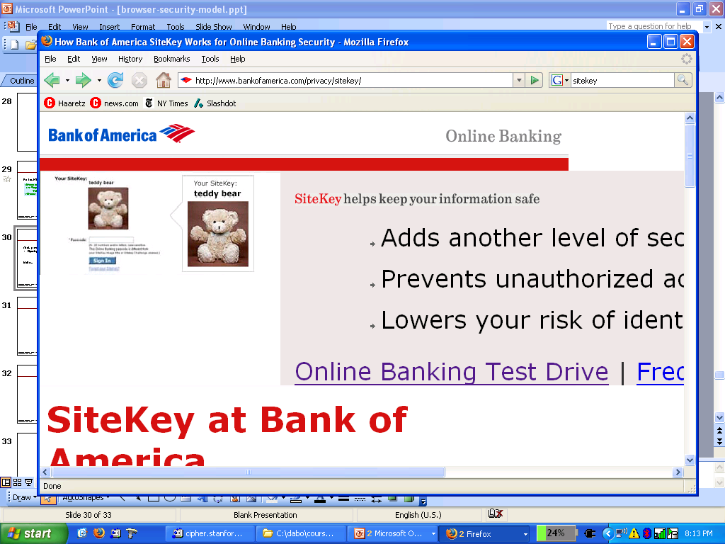
Frame Busting
Goal: prevent web page from loading in a frame
example: opening login page in a frame will display correct passmark image
Frame busting:
if (top != self)
top.location.href = location.href

Slide 11
Better Frame Busting
Problem: Javascript OnUnload event
Try this instead:
<body onUnload="javascript: cause_an_abort;)">
if (top != self)
top.location.href = location.href
else { … code of page here …}

Slide 12
Summary
Http
Rendering content
Isolation
Communication
Navigation
Security User Interface
Cookies
Frames and frame busting

Slide 13
Lecture 5: Web Client Security
Total 6 Modules on Web Client Security
Module 5.1: Web Security Landscape
Module 5.2: Web Security Definitions, Goals and Threat Models
Module 5.3: HTTP & Content Rendering
Module 5.4: Browser Isolation
Module 5.5: Security Interface
Module 5.6: Cookies, Frames and Frame Busting

